Slide 1

Sprint – 3
UPDATING DATA IN THE DATABASE

Slide 2
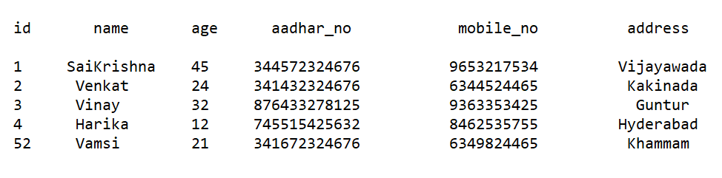
Creating AN APPLICATION FOR UPDATING DATA

Slide 3
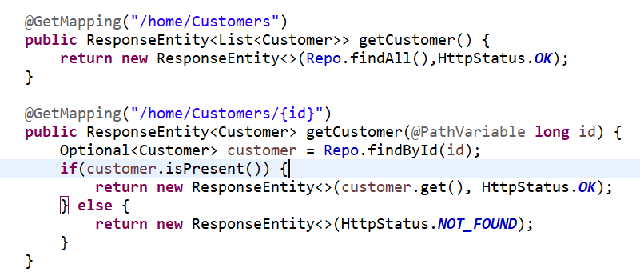
GET OPERATION USING POSTMAN

Slide 4
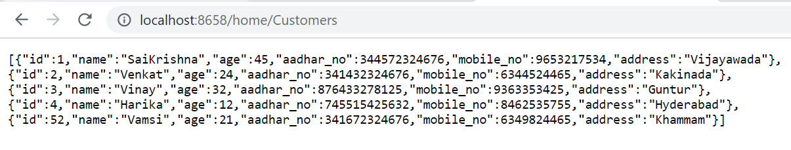
The output of this program using browser:

Slide 5
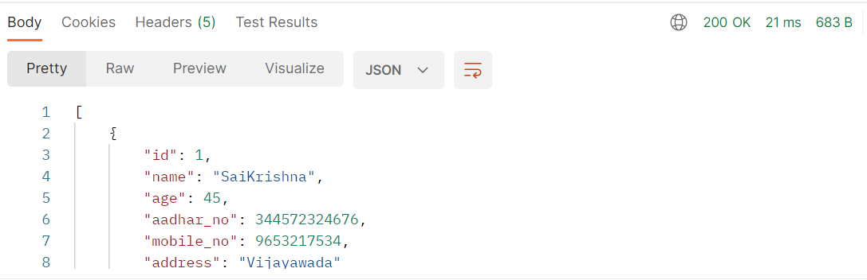
The output of this program using postman:
Add ‘GET’ method and enter the URL and click on send.
Output:

Slide 6
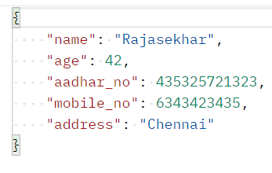
Post operation using postman
To use ‘POST’ method in the postman, select ‘POST’ method, click on body and raw and select JSON format.
Then enter the data in the JSON format.
After entering the data in the JSON format, then click on send.

Slide 7
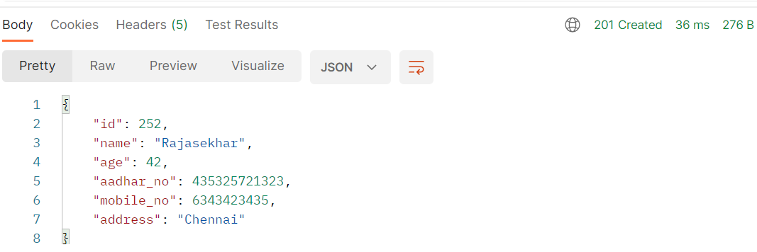
THE OUTPUT OF THIS PROGRAM USING POSTMAN:

Slide 8
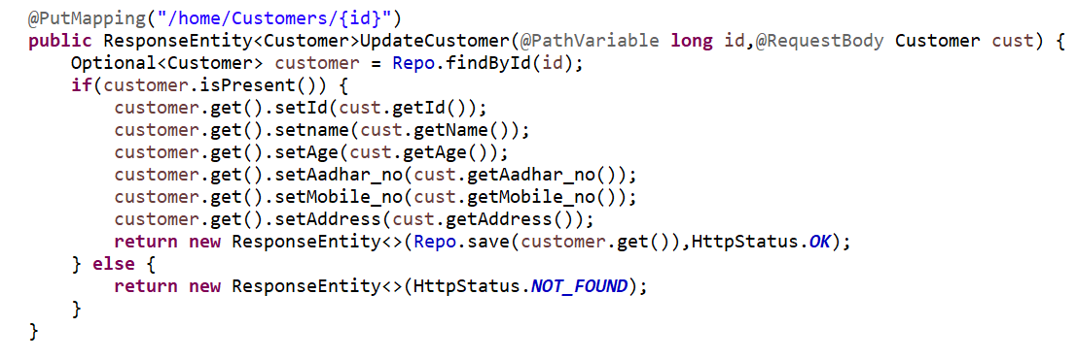
to update data in the MySQL:

Slide 9
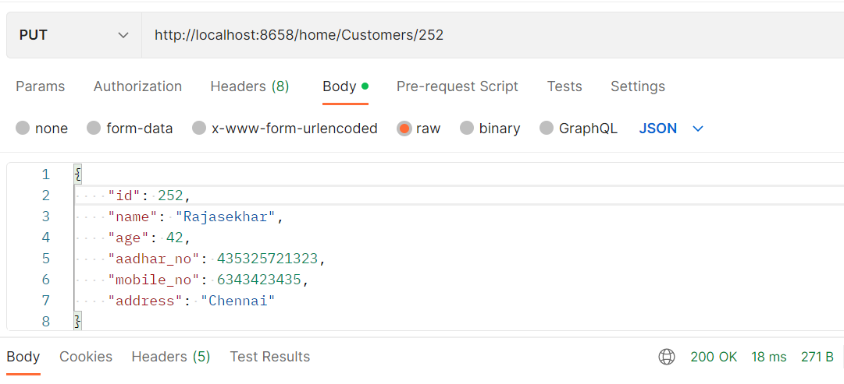
We can update table by using id.
In Postman, using PUT method we can update the table.

Slide 10
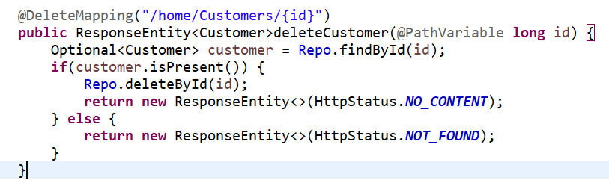


Deleting data in the database using postman:
Select ‘DELETE’ and type the URL and click on send. After deleting data, it shows the status code ‘No Content’.

